Slide 1
ABC Healthcare Customer Request Resolution Process OPIM 5272: Business Process Modeling

Slide 2

Agenda
Company Overview
Current State Process
Pain Points and Enablers
Future State Process
Data Model
Database Demo
Conclusion and Next Steps
Notes:
Carolyn

Slide 3
ABC Healthcare Overview
75 year old managed health care insurance company
Provides individual health insurance plans to 5 million members
Member of Fortune 500 with annual revenue of $12M
Enroll Member
Process Claims
Respond to phone calls
Answer complaints
Handle appeals
Customer Request Resolution Process
Notes:
Carolyn

Slide 4
Customer Request Resolution Process
A collection of interrelated tasks, initiated in response to an event, achieving a specific result for the customer and other stakeholders.
Interrelated Tasks
Route request
Event
Member contacts ABC Health with inquiry, complaint, or appeal.
Result
Resolve member inquiry, complaint, or appeal
Customer
Stakeholders
Member
ABC Health
Members
Shareholders
Log request
Look up member information
Resolve member concerns
Close request and log resolution
Notes:
Carolyn

Slide 5
3 Types of Requests
Type | Format received | Handler | System | Other
Inquiry | Phone Call | Customer Service Representative | Inquiry System | May turn into complaint or appeal
Complaint | Phone Call E-mail Fax Letter | Complaint Analyst | Complaint System | May turn into appeal
Appeal | E-mail Fax Letter | Complaint Analyst | Appeal System | May require information from physicians to resolve
Notes:
Trish
3 types of requests – use example of a customer calling with a question about a drug being covered, then they go to the pharmacy and it isn’t so they call to complain. Original CSR gave the wrong information, so they appeal.
Due to mergers and acquisitions over the years, we have disparate systems. One area might use an access database, another might us a host system (aka green screens).

Slide 6
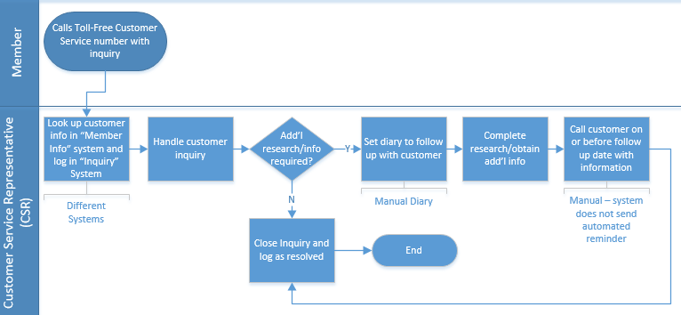
Current Process - Inquiries
Notes:
Trish
Use real life example
Also note that this is a very high level process flow – there are additional steps like what to do if customer is not satisfied, must escalate to manager, etc, but for presentation purposes we are not showing that here. Also this is just the inquiry process – again for presentation purposes we are not showing complaint and appeal. They are similar.
Note pain points – look up info in member system and log in inquiry system, different systems; manual diaries

Slide 7
Pain Points and Enablers
Disparate Systems
Manual follow ups
Cannot see prior requests
Multiple CSRs for same request
Manual reporting process
Enablers: Information Systems
Notes:
Trish
Pain points:
Systems don’t talk to each other. Separate system for customer info, inquiries, complaints, and appeals – if you call with an inquiry that turns into a complaint, we have no way of knowing that you called in the first place. And each time the service rep needs to look up information in the customer info system.
If follow up is needed, it must be set manually by the rep. No best practices around how to do that, not consistent
Cannot easily access a prior request to look at customer history when a new request comes in. What if a customer has called 10 times with the same inquiry? Would we want to handle that differently than a first time caller?
Multiple CSRs – if you call multiple times on the same inquiry, you could get a different person each time and repeat a lot of information. Would it be possible to create one case handler for one request?
Manual reporting process: if a senior executive wants stats, analyst must go to multiple different places to pull together information. There is no consistent data governance, so reporting is tedious and manual.
Enablers: similar to the example ppt that was posted on husky ct, the main enabler is the information systems. Workflow design, Motivation and measurement, human resources, policy and rules, and facilities/others are not really the issues – the issue is that we are trying to manage what is truly one process in multiple disparate systems that do not communicate.
Transition: so, what do we do. We decided to improve the process in two ways. First we looked at the process of triaging and routing requests as they come in the door, and then we looked at the process of setting diaries for follow up.
Workflow design
Not much to be done here …
Information systems
THE KEY
Motivation and Measurement
Not much to be done here …
Human resources
Workers are great!
Policies and rules
Not much to be done here …
Facilities (and others)
Everything is ok here

Slide 8
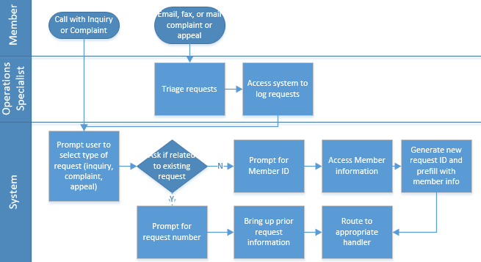
Future State Process Flow – Triage and Route Requests
Notes:
Trish
Remember original process is not driven by the system, it is all manual. We thought can we automate anything before we get the user to a representative that would give the rep more time to spend on actual customer service vs messing around looking things up in disparate systems. We also decided to create one up front process for all types of requests – inquires, complaints, and appeals. Note that the main difference is how the company may receive a request, by phone call or by email, fax, or snail mail.

Slide 9
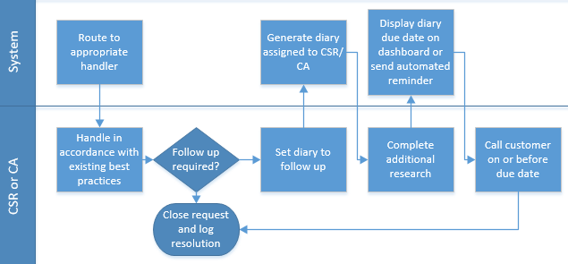
Future State Process Flow – Generate Diary
Notes:
Trish
If follow up required, the rep must set the diary in the system. Standardizing the process and putting best practices around it. Then we can either send automated notifications about diaries or display to rep and their manager on a dashboard. Also gives leadership the ability to monitor who is hitting their diaries and if anyone is not meeting expectations.

Slide 10
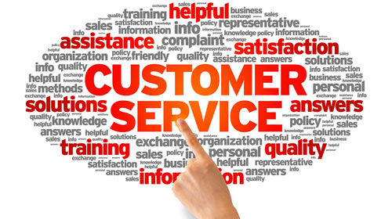
Future State Process Benefits
One system to:
Look up customer information
Log requests and outcomes
Route work and set diaries for follow up
Benefits:
Quicker handling
Route more difficult requests to correct resources
Improved customer satisfaction
Process transparency = improved data and reporting → improved analytics
Can we predict “problem” customers before they are a problem?
Notes:
Trish

Slide 11
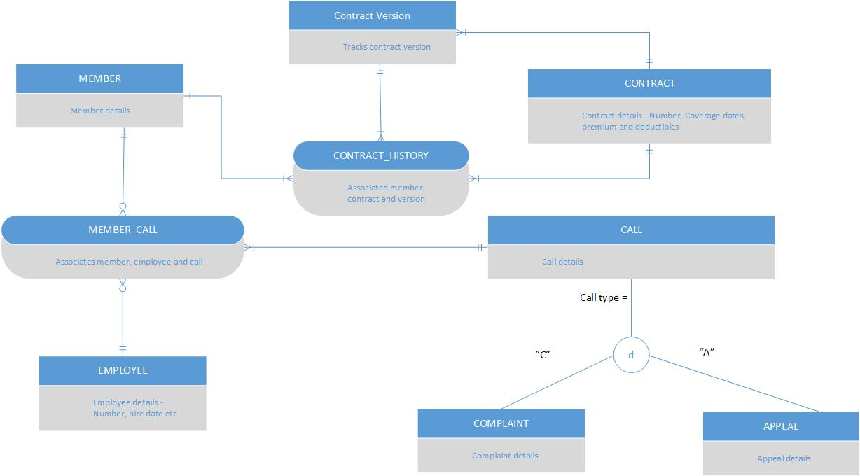
Data Model
Notes:
Prasanth

Slide 12
Database Demo
Database connects multiple systems
Member information → Inquiries → Complaints → Appeals → CSRs
What business questions might leadership ask?
What is the profile of customers by age?
What is the volume of calls and appeals handled by each employee?
What is each employee’s rate of resolution, compared to the baseline?
What is the volume of complaints and appeals per year?
Which members have the highest volume of complaints and appeals?
Notes:
Muhammad
Emphasize how questions add business value: for example, last question speaks to customer satisfaction. Could we then use this information to build a predictive model or change how we handle customers with high volumes of complaints and appeals?

Slide 13
Next Steps
With a consolidated database, ABC Health leadership will be able to receive business intelligence (reports) that will enable them to analyze customer service across their organization and therefore make better decisions.
For example, they will be able to see visual analytics by means of an “Executive Dashboard” that uncovers trends and patterns that were previously undetectable. These insights can prompt management ACTION to make improvements to customer service and, ultimately, increase profits.
Notes:
Marcia

Slide 14
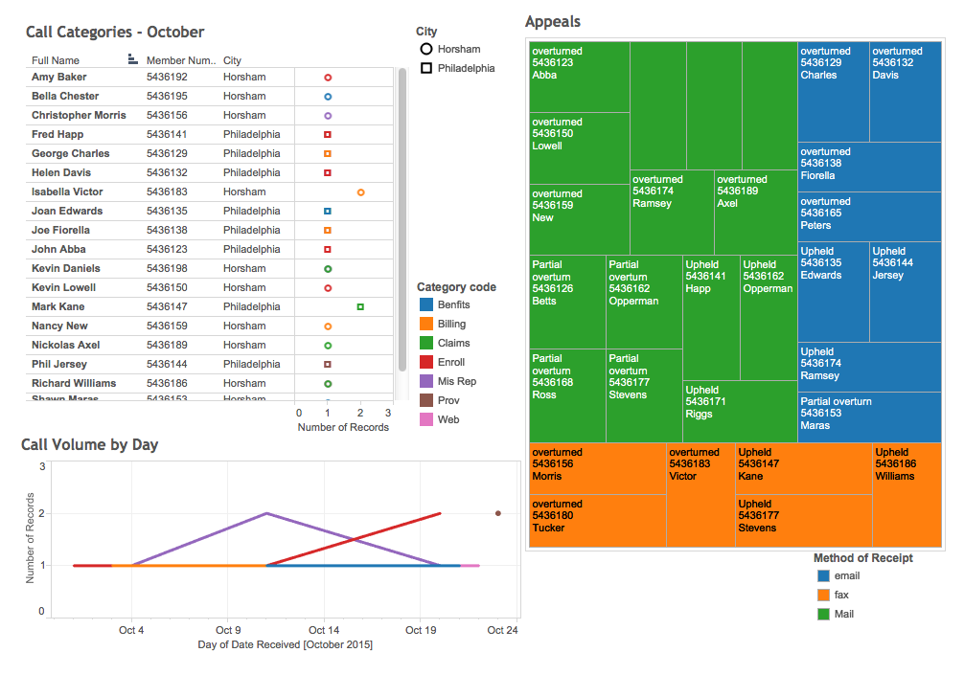
Example Dashboard
Notes:
Marcia

Slide 15
Conclusion
ABC Health has grown as a result of multiple mergers and acquisitions...this has led to the proliferation of different platforms/systems to handle the customer service process.
To provide more effective customer service to their members, they should re-engineer the customer service process (inquiries, complaints, and appeals).
With one standardized process and a consolidated database system, ABC Health can provide better customer service and provide corporate leadership with the tools to make better strategic decisions.
Notes:
Marcia

